Slide 1


EMPLOYEE RISK ATTRITION: Predicting and preventing turnover
Name: Yogitha Mekala
UMKC ID: 16354649

Slide 2

The Challenge: Employee Turnover
High turnover costs companies time and money.
Unpredictable employee exits hurt team morale and productivity.
Need for better tools to predict and prevent turnover.

Slide 3

Our Solution: Employee Risk Attrition
A predictive analytics tool to forecast employee departures.
Uses AI to analyse real-time employee data.
Provides actionable insights to reduce attrition risk.

Slide 4

Why It Matters?
Personal experience seeing companies struggle with high turnover.
Saw a gap in tools that could predict employee exits before it’s too late.
Passion for using data to solve real-world problems.

Slide 5

What Makes It Unique?
Real-time data analytics that adapts to employee behavior.
Predictive insights give HR teams time to take action.
This Photo by Unknown Author is licensed under CC BY-NC

Slide 6

The Challenges
Data access and privacy concerns.
Convincing companies to invest in preventive measures.

Slide 7
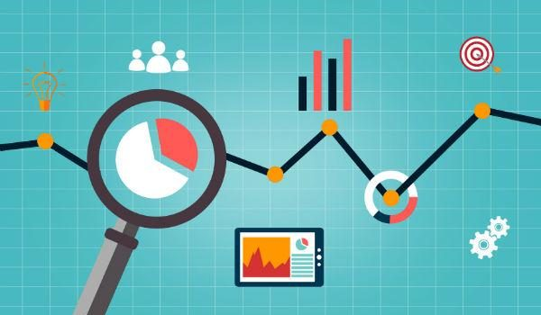
Prototype: How It Works
Interactive dashboard with risk heatmaps.
Risk scores based on employee engagement and behavioral patterns.
Early-warning alerts for HR teams.
This Photo by Unknown Author is licensed under CC BY-SA-NC

Slide 8

The Impact: Why It Matters
Reduce turnover and save recruitment costs.
Improve employee engagement and retention.
Foster a more stable and motivated workforce.
This Photo by Unknown Author is licensed under CC BY

Slide 9

Thank you

